Slide 1

Data Security health map
Castle Ventures
Team Member:
Joel Ulahanna (PM)
Varun Shah
Aditya Gumastedesai
Viral Patel

Slide 2
The goal of the project is to build an application that will make it easy for the company to identify and track its sensitive data so that the security team can protect it effectively.

Slide 3
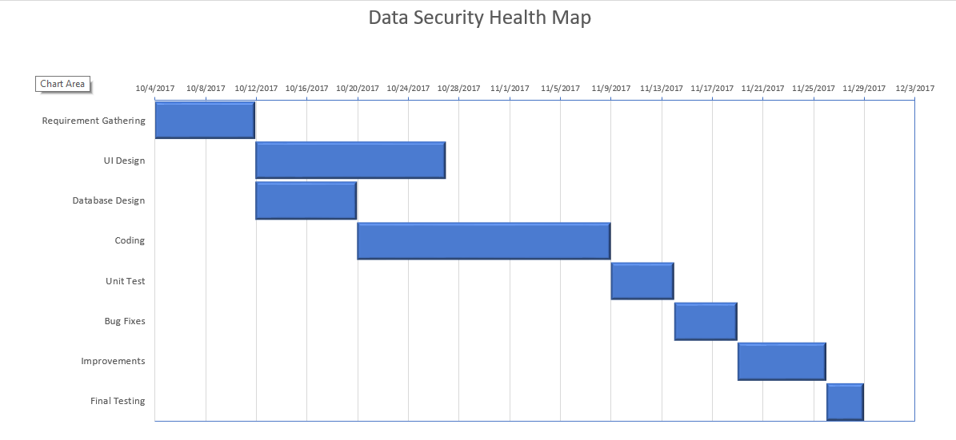
Gannt Chart

Slide 4
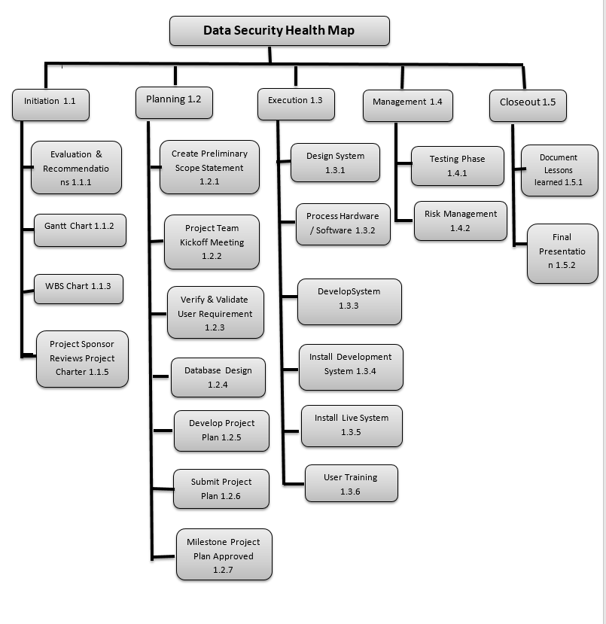
WBS Chart

Slide 5
UI setup

Slide 6
Working

Slide 7
Database setup

Slide 8
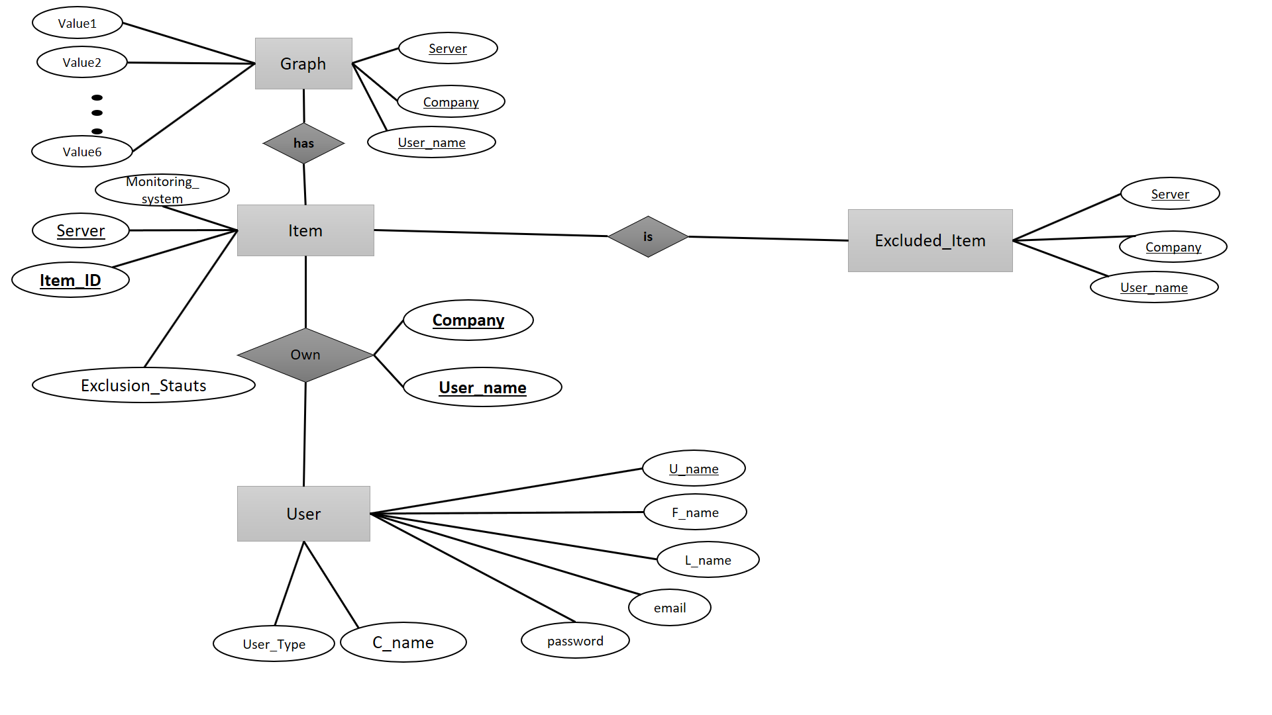
ER Diagram

Slide 9
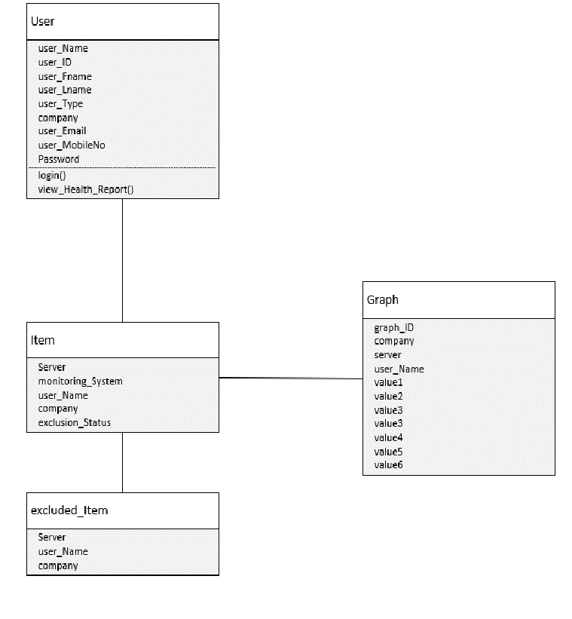
Class Diagram

Slide 10
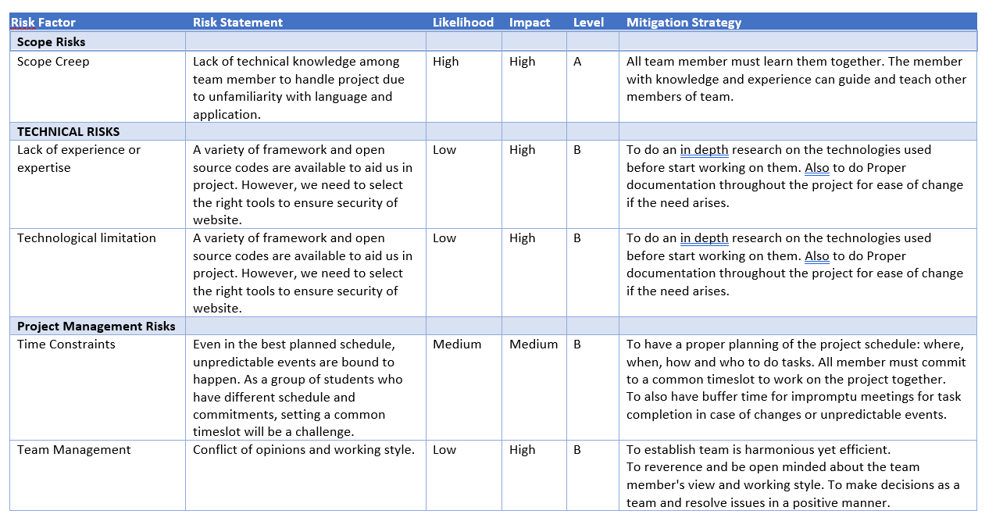
Risk Analysis

Slide 11
Version 2.0
Include information about threats and threat analysis
Ability to generate report from the system.
Ability to include remediation tips based upon weaknesses that are identified.

Slide 12
Thank you

